Slide 1
PLB 812 Plant Genomics
8-25-25
Introduction to genomics and our course this semester
Dr. Bob VanBuren

Slide 2
Course details
Instructors
Dr. Bob VanBuren (he/him), Plant Biology 262, vanbu31@msu.edu (75% course instruction)
Dr. Emily Josephs (she/her), Plant Biology 264, josep993@msu.edu (25% course instruction)
Time and Place
Monday and Wednesday 10:20-11:40 (but we will be available until 12:10), Plant Biology 151 and Zoom (upon request)
Office hours
Upon request (send us an email!)

Slide 3
Course details
Instructors
Dr. Bob VanBuren (he/him), Plant Biology 262, vanbu31@msu.edu (75% course instruction)
Dr. Emily Josephs (she/her), Plant Biology 264, josep993@msu.edu (25% course instruction)
Time and Place
Monday and Wednesday 10:20-11:40 (but we will be available until 12:10), Plant Biology 152 and Zoom (upon request)
Office hours
Upon request (send us an email!)
The course will involve lectures, paper discussions, and lab activities. There will also be general discussions on topics related to publishing, grant funding, data reproducibility, and ethics in biology. Each major topic will be accompanied by a lab activity where students will utilize publicly available bioinformatic resources via the MSU high performance computing infrastructure to analyze genomic data. These Jupyter notebooks will often contain advanced techniques and instructions beyond the scope of this course that can serve as valuable resources for your own research in the future.

Slide 4
Course details
Course goals
The course will synthesize concepts from computational and genome sciences with plant biology principles.
The goals for this course are for students to:
(1) acquire foundational knowledge and skill sets in plant biology and data science.
(2) formulate hypothesis-driven questions stemming from grand challenges at the interface of plant genomics and data sciences
(3) Synthesize acquired skills to collaboratively solve complex questions.
(4) communicate persuasively across disciplines and cultures with peers and the public
By the end of the course, students will be able to identify and create strategies to address current
problems in plant biology using cutting edge computational tools and genomic approaches. Through interactive lectures and applied labs, students will learn to communicate across disciplines to explore emergent biological processes.

Slide 5
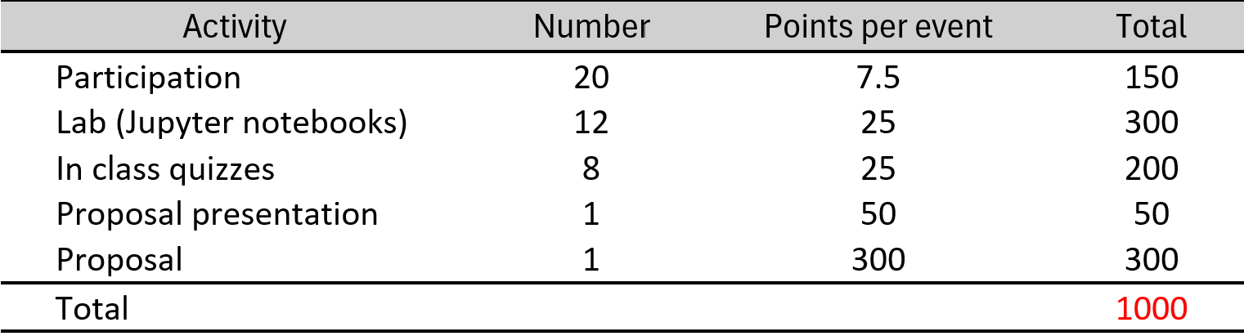
Course details
Participation: Attending class and actively participating, including reading and discussing assigned papers, earns you 7.5 points per class, with extra credit for more than 20 attendances, contributing to a total score of 1000 points.
Jupyter notebooks: Labs involve using Jupyter notebooks for genomics activities on MSU's HPCC, with full credit given for attempted work and submitting within 48 hours of class.
In class quizzes: There will be 8 in-class quizzes during the semester, each will consist of a single open-ended, thought-provoking question designed to assess your ability to apply and synthesize key plant genomics concepts. These are not recall-based quizzes, and there is no single correct answer. Full credit will be awarded for responses that are well-reasoned and show evidence of engagement with course materials and concepts.
Grant proposal: Craft an NSF-style research proposal including a project narrative, data management plan, budget, and justification, with feedback provided throughout; this major component builds skills for academic and professional advancements.
Proposal presentation: A 5-minute elevator pitch is required to present your research proposal, emphasizing objectives and significance.

Slide 6
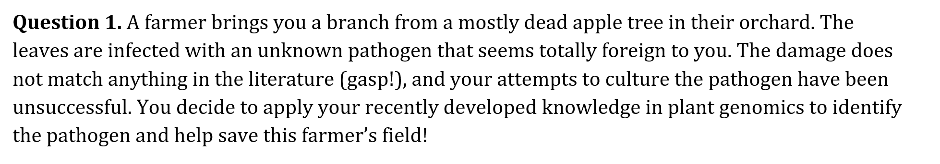
Example quiz question

Slide 7
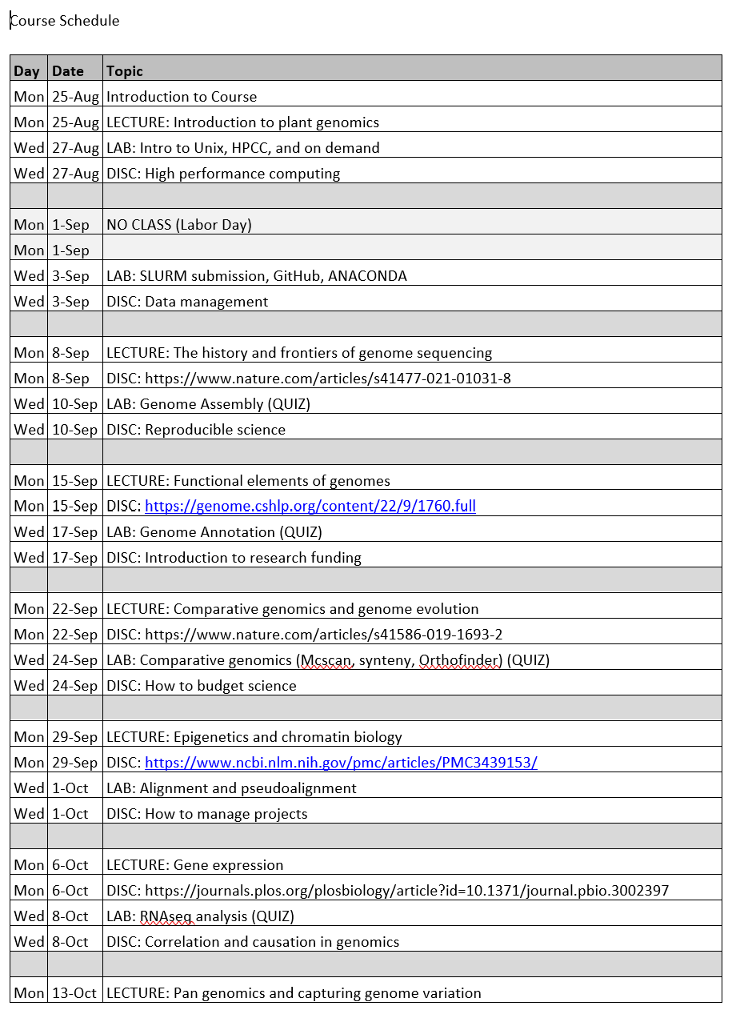
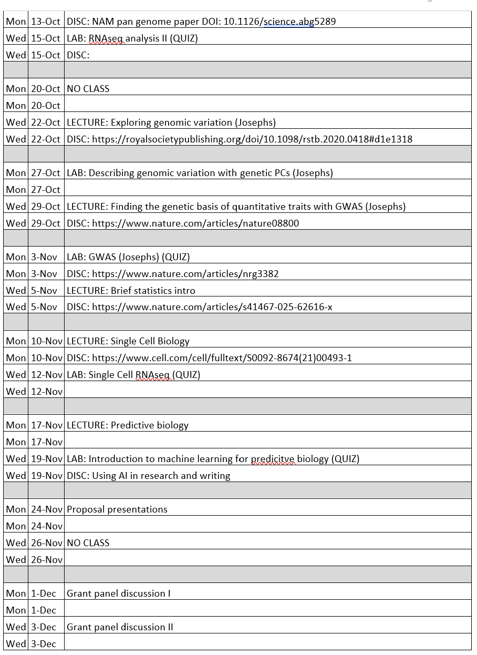
Course details

Slide 8
Use of AI in our course
ChatGPT and other large language model based chatbots can be powerful tools for coding, computational biology, and bioinformatics, but they must be used with caution
You are free to use these programs for troubleshooting and problem solving in our course, but ChatGPT is not a substitute for developing a deeper understanding of the course concepts.

Slide 9
Course details
How many of you have used the MSU HPCC?
How many of you have experience with Unix?
How many of you have some familiarity with Github?
How many of you have some familiarity with Python?
Note: None of these are prerequisites for our course!

Slide 10
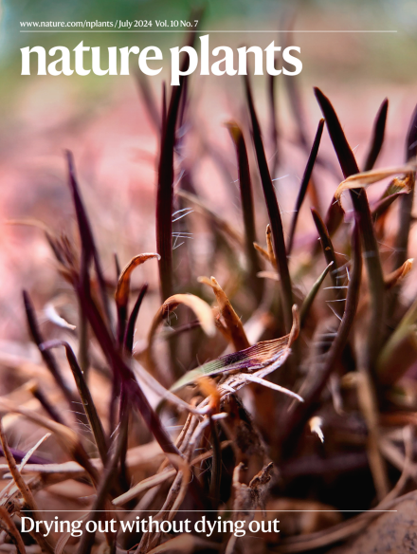

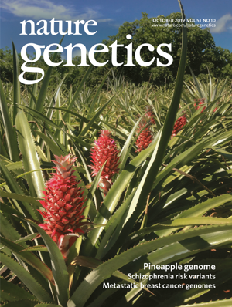
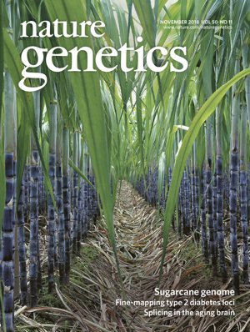
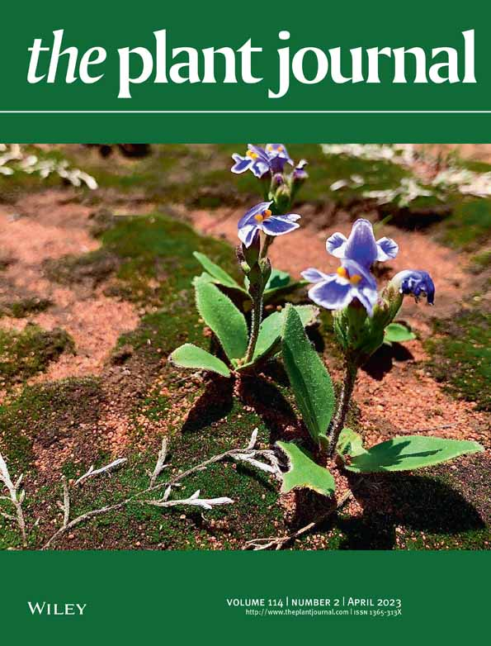
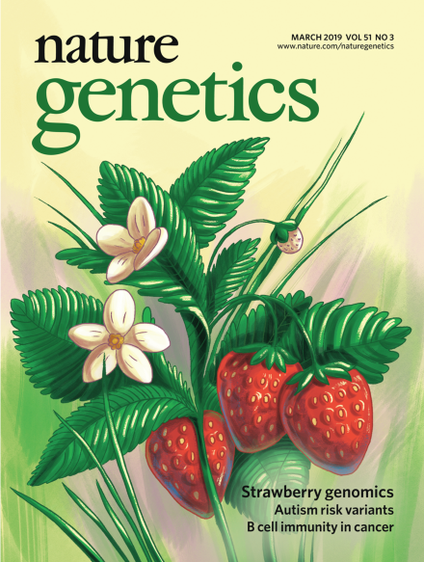
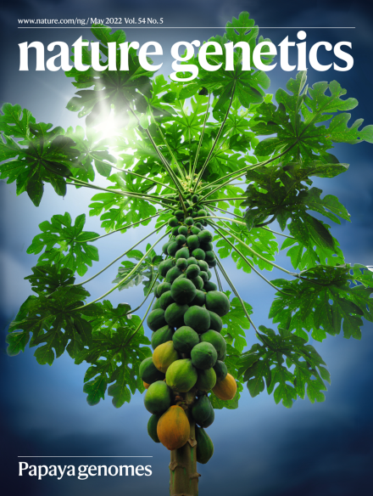
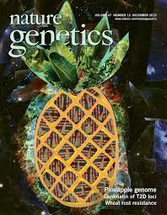

Genomics work in the VanBuren Lab
The VanBuren lab has sequenced dozens of plant genomes including crops (pineapple, papaya, sugarcane, raspberry, strawberry, coffee, hazelnut, sour cherry, blueberry, lotus, teff) and wild species with interesting traits.
Sequencing technologies, techniques, assembly strategies, and costs have changed dramatically over the ~15 years we have been sequencing plant genomes
plantresilience.msu.edu

Slide 11

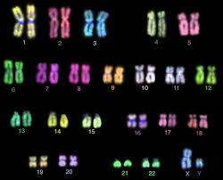
Overview of the genome
Maize genome
Human genome and maize genome are similar in size (3 Gb vs 2.3 Gb)
Terminology:
1kb = 1,000 base pairs of DNA
1Mb = 1,000,000 base pairs
1 Gb = 1,000,000,000 base pairs
1-20% of plant genomes is coding (genic)
The rest (intergenic) is classified as ’other’
Some regions are functional (structural or regulatory), others have unknown or no function
Plant Genomes have between ~20,000-200,000 genes
Human genome
plantresilience.msu.edu

Slide 12
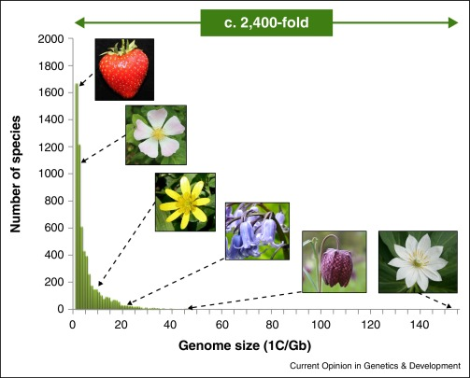
Plant genomes have ~2,400 fold variation in size. This is driven by repetitive element proliferation and polyploidy. Despite this variation, most genomes have similar gene content (~10 fold).
Plant Genomes are wildly variable
plantresilience.msu.edu

Slide 13
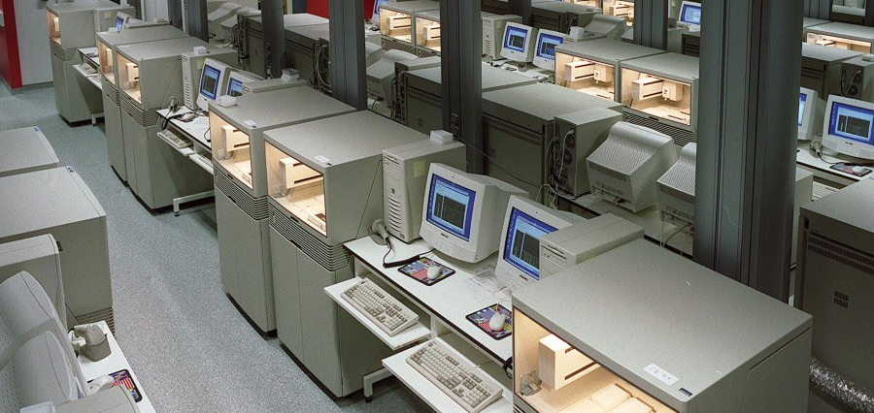
The earliest genomes were very expensive
Automated Sanger Sequencing
2001
2001
2002-2005
Human genome 3.3 Gb
$3.3 Billion, 13 years
Arabidopsis genome 125 Mb
$100 Million
Rice genome ~450Mb
$100 Million
plantresilience.msu.edu

Slide 14
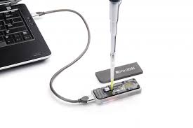
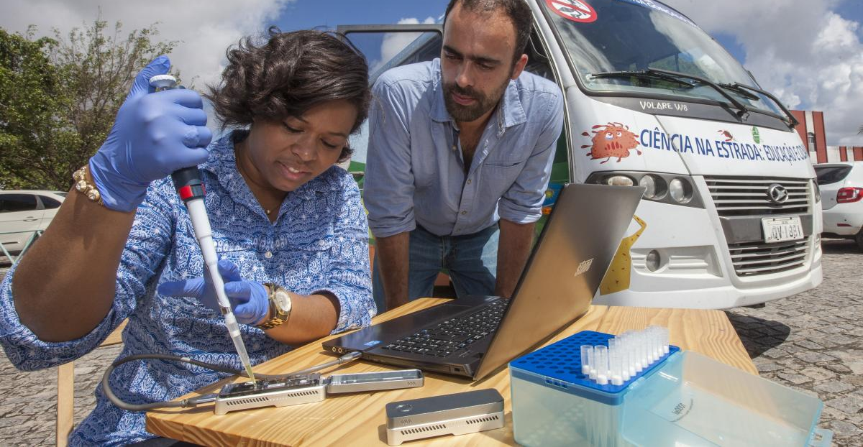
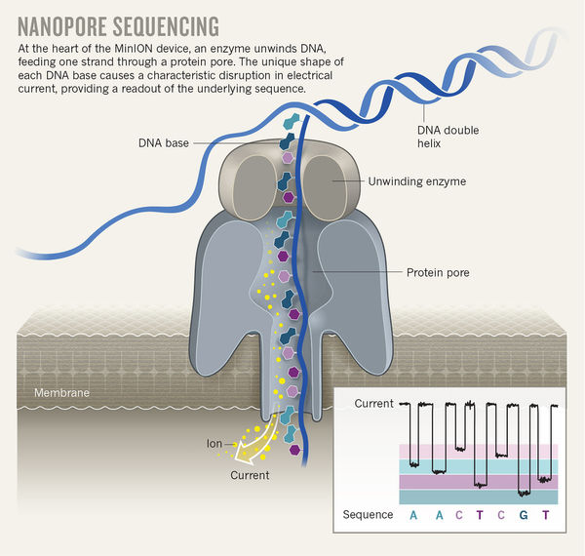
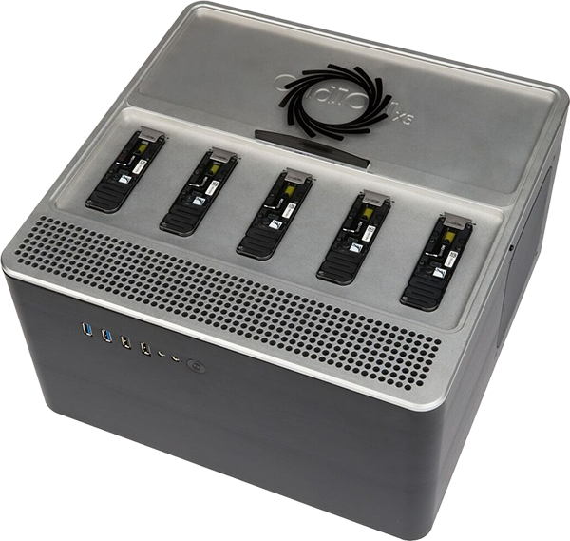

Sequencing your favorite plant would now cost $1,000-10,000
plantresilience.msu.edu

Slide 15
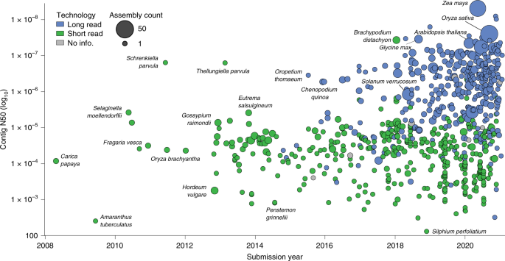
Over 2000 plant genomes have been sequenced to date
plantresilience.msu.edu

Slide 16
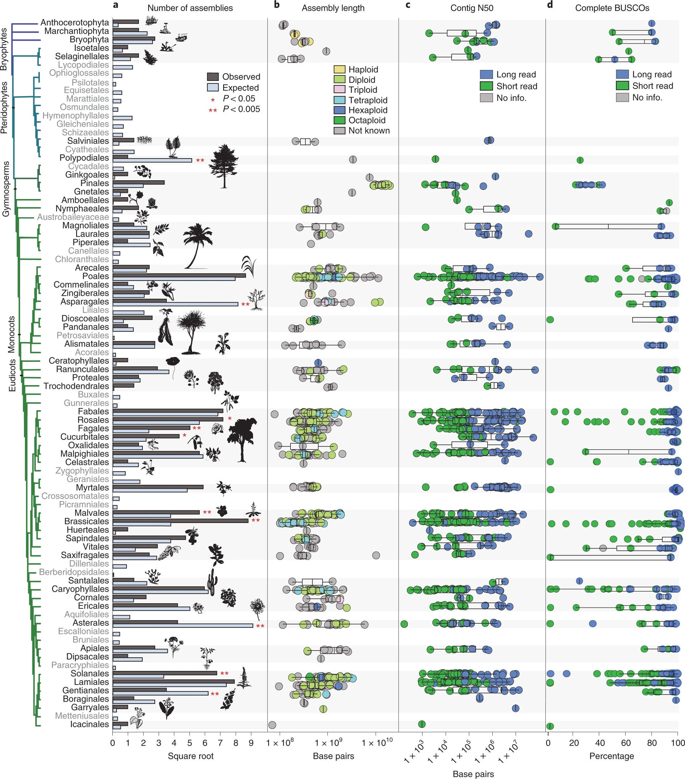
Over 2000 plant genomes have been sequenced to date
2,373 genomes of 1,031 species are available (as of early 2024)
Genomes are available for species in > 90 orders with the most common being Poales (346), Rosales (199), and Brassicales (198)
No genomes from aracryphiales (Eudicots), Liliales (Monocots) and Austrobaileyales (Amborellales, Nymphaeales, Austrobaileyales; ANA clade)
plantresilience.msu.edu

Slide 17
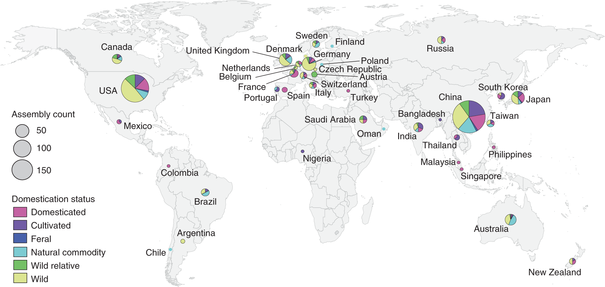
Global inequalities in genome sequencing
plantresilience.msu.edu

Slide 18
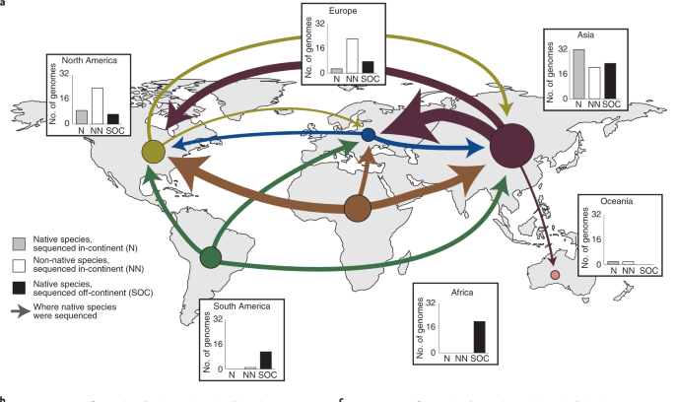
Global inequalities in genome sequencing
Much of the global diversity of plants is found in the Global South, including most domesticated crops, but most genome sequencing efforts have been led by countries in the Global North and China
plantresilience.msu.edu

Slide 19
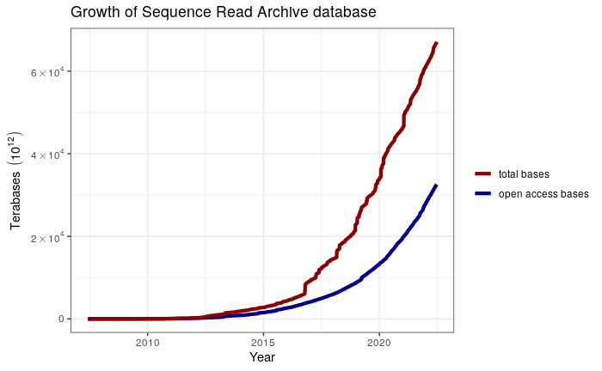
Public sequencing data is growing exponentially
The NCBI sequence read archive (SRA) is the largest database of public genomics data
As of 2021, the SRA contains > 26 peta base pairs of over 15 million datasets (runs)
26,000,000,000,000,000 bp
or 13 million maize genomes
plantresilience.msu.edu

Slide 20
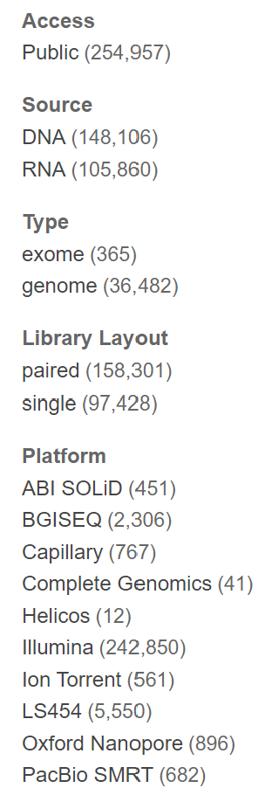
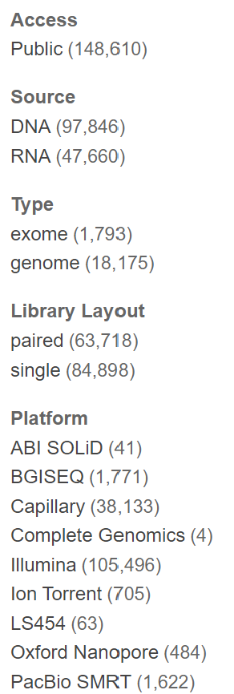
Public sequencing data is growing exponentially
Arabidopsis
Maize
Over 1 million samples from plants on the NCBI SRA, > 100k independent BioProjects (i.e., independent experiments)
Maize and Arabidopsis have the most samples (254k and 148k, respectively)
Includes whole genome sequencing/resequencing, gene expression (RNAseq), methylation (Bisulfiteseq), chromatin datasets (ChIPseq, ATACseq, DAPseq), and single cell data, among others.
plantresilience.msu.edu

Slide 21
Biologists generate a lot of data
Some open questions to think about this semester
What are the best practices for analyzing these large-scale genomic datasets?
What’s out there? How can we re-analyze, combine, and re-use the wealth of public data to answer biological questions?
How do we ensure our analyses are robust and reproducible?
plantresilience.msu.edu

Slide 22

How do we make sense of all this data?

Slide 23
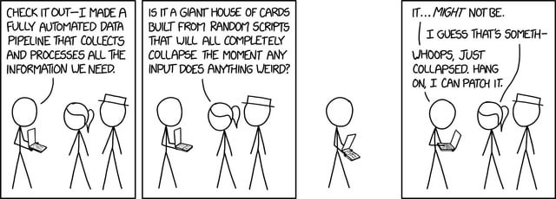
Bioinformatics in a nutshell
plantresilience.msu.edu

Slide 24
Bioinformatics in a nutshell
Many of the core bioinformatics algorithms were developed in the 80s-90s and have been continually improved and stitched together into tools that we still use today
Hidden Markov Models (HMM)(1980s)
BLAST (Basic Local Alignment Search Tool) (1990)
BWT (Burrows-Wheeler Transform) (1994)
De Bruijn Graph Algorithm (1990s)
Markov Chain Monte Carlo (MCMC) (1980s)
Maximum Likelihood Phylogenetic Methods (1981)
Clustal (1988)
plantresilience.msu.edu

Slide 25


Slide 26
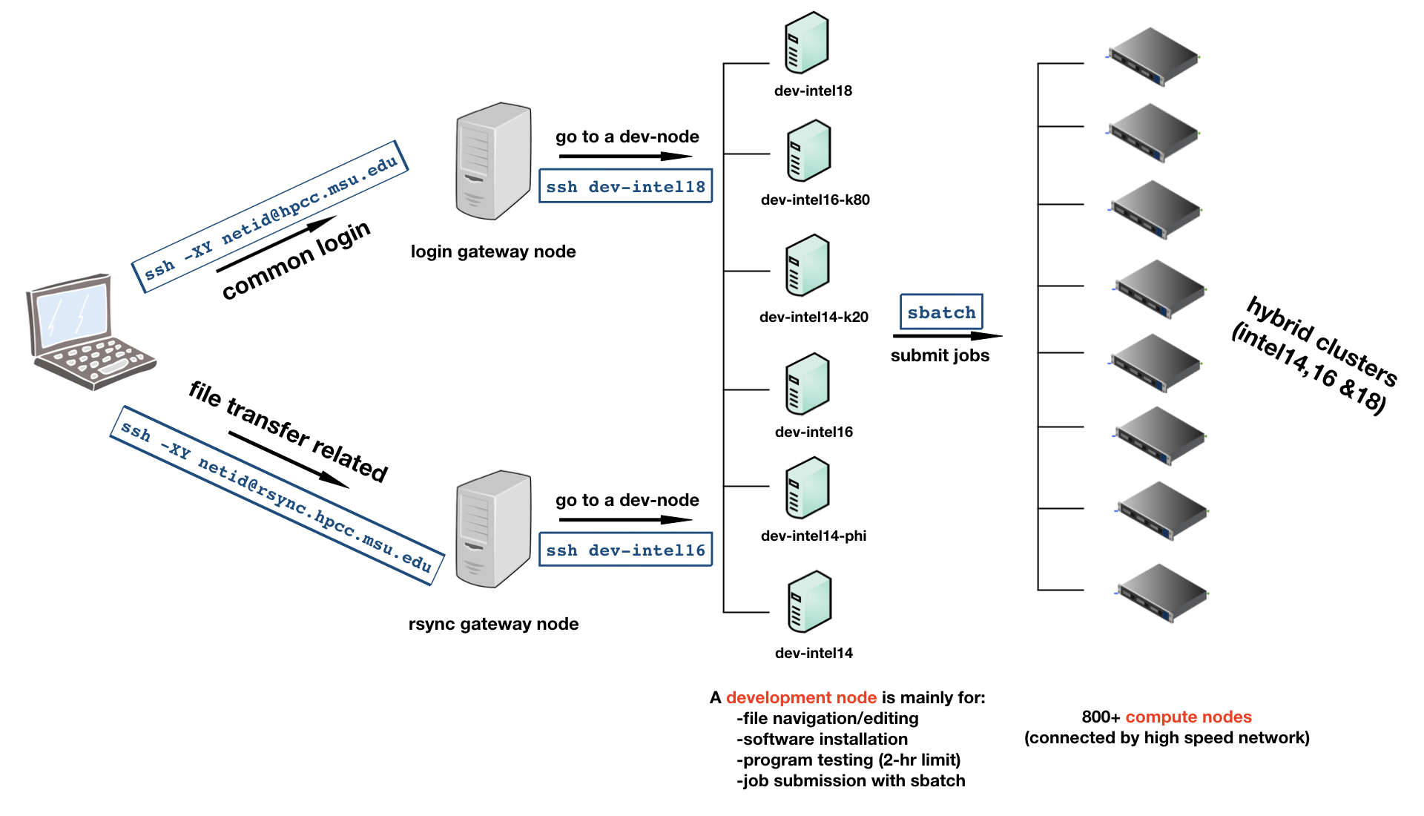
MSU High performance computer cluster (HPCC)
MSU HPCC has >50,000 cores
Thousands of GPUs
3.9 petaflops of computational capacity
HPCC uses a queuing system where users get priority access to nodes they pay for, and you can use any nodes that are currently available
plantresilience.msu.edu

Slide 27
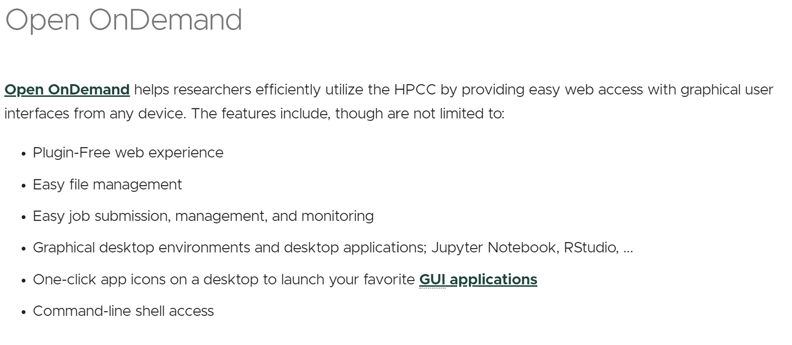
MSU High performance computer cluster (HPCC)
OnDemand on HPCC is relatively new, there may be bugs!
plantresilience.msu.edu

Slide 28
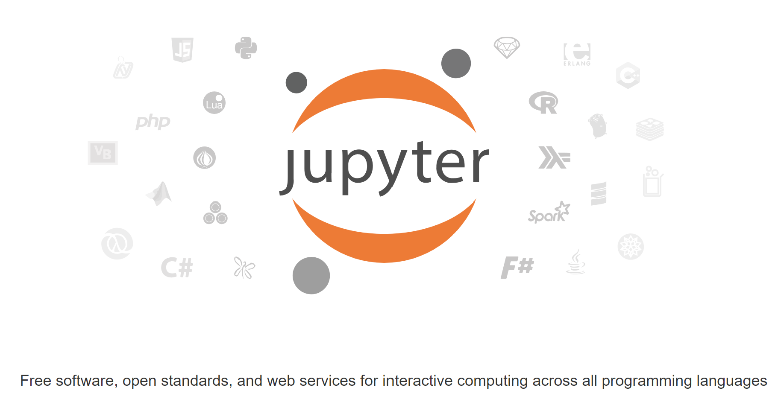
Jupyter notebooks
https://plantsandpython.github.io/PlantsAndPython/O_8_GENOMICS_AND_BIOPYTHON/0_Lessons/8.1_HPCC.html
plantresilience.msu.edu

